Slide 1


Azure Cognitive Services in Container
Abhishek Mishra
Software Engineer at Virtusa

Slide 2






$ whoami
Pythonista
I try to solve most of software problem with Python
Experimenting solution and architecture in cloud
@stalwartcoder
@abhishekmishra2308

Slide 3
What to expect ?
What are Cognitive service and its types?
What are cognitive service containers ?
Container support for Azure cognitive services
How to use cognitive service containers?
Demo : Running Text analytics cognitive service container

Slide 4
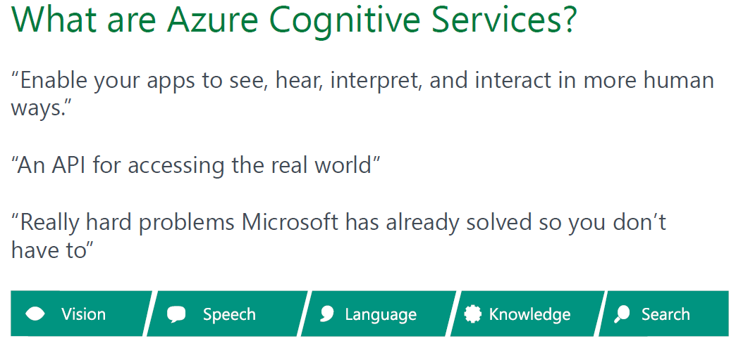

Slide 5
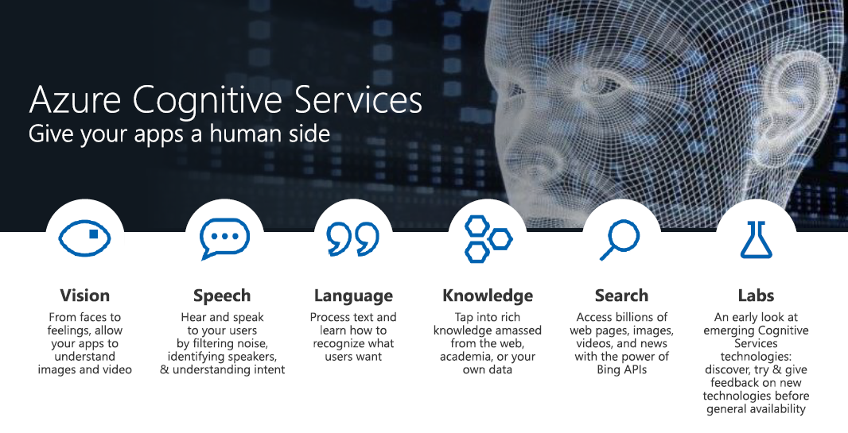

Slide 6

Cognitive Services
microsoft.com/cognitive
Vision
Speech
Language
Knowledge
Search
Computer Vision
Custom Recognition
Bing Spell Check
Academic Knowledge
Bing
Web Search
Emotion
Speaker Recognition
Linguistic Analysis
Entity Linking
Bing
Image Search
Face
Speech
Language Understanding
Knowledge Exploration
Bing
Video Search
Video
Translator
Text Analytics
Recommendations
Bing
News Search
WebLM
Bing
Autosuggest

Slide 7
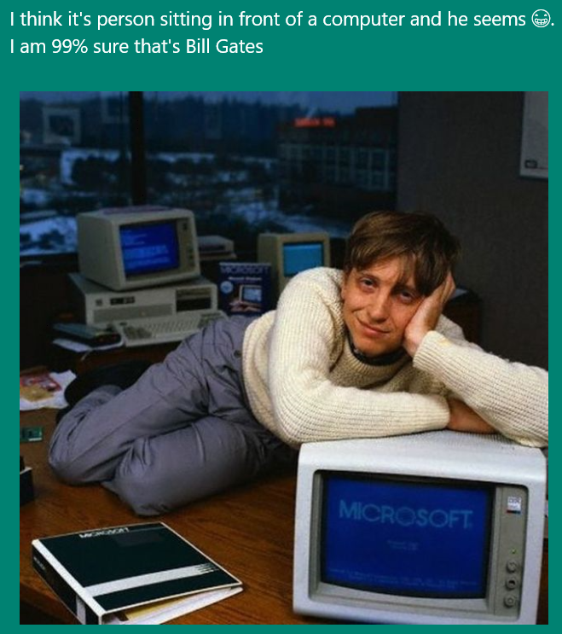
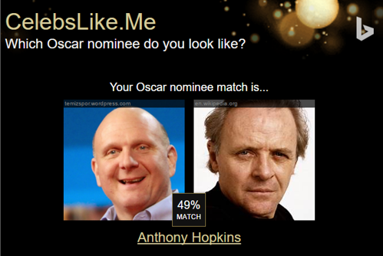
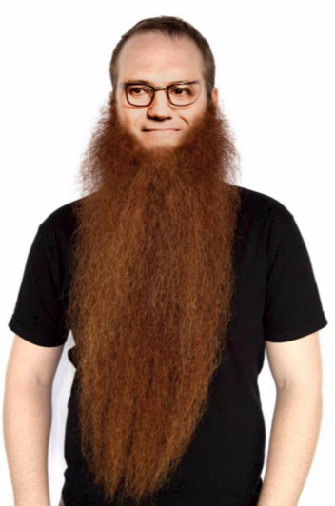
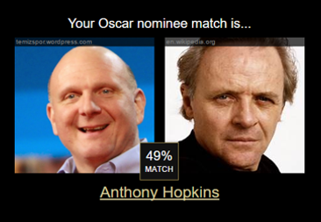
Apps Powered by MS Cognitive Services
I think it’s a person sitting in front of a computer and he seems ☺. I am 99% sure that’s Bill Gates
CaptionBot.ai
Celebslike.me
ProjectMurphy.net

Slide 8







Why Microsoft Cognitive Services ?
Easy
Flexible
Tested
Roll your own with REST APIs
Simple to add: just a few lines of code required
Make the same API code call on iOS, Android, and Windows
Integrate into the language and platform of your choice
Built by experts in their field from Microsoft Research, Bing, and Azure Machine Learning
Quality documentation, sample code, and community support
GET A KEY
BUILD

Slide 9
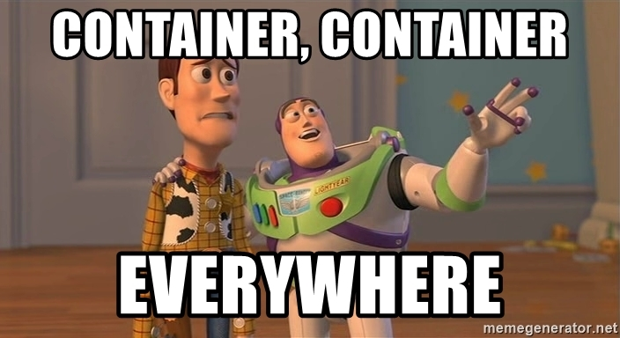

Slide 10
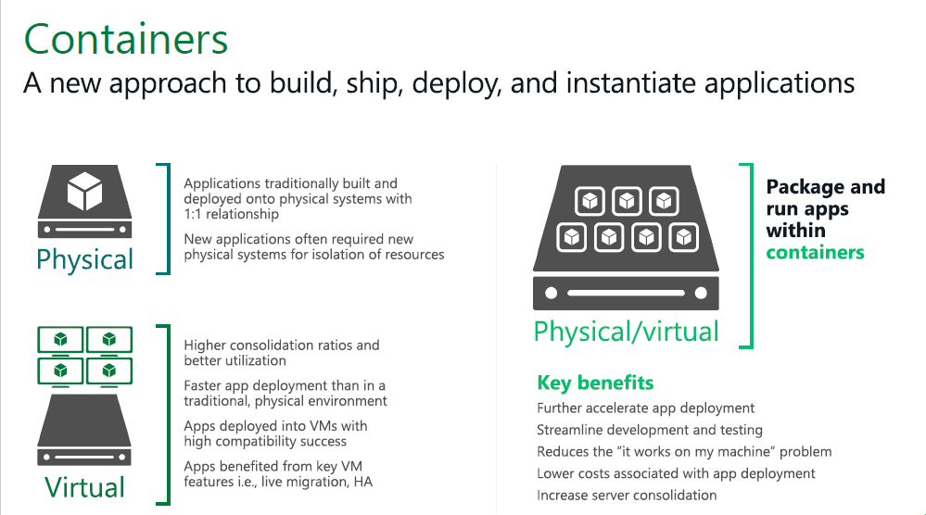

Slide 11
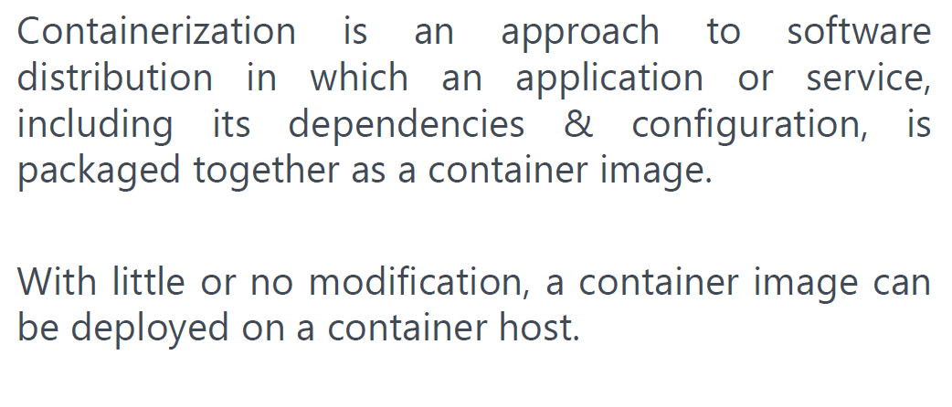

Slide 12
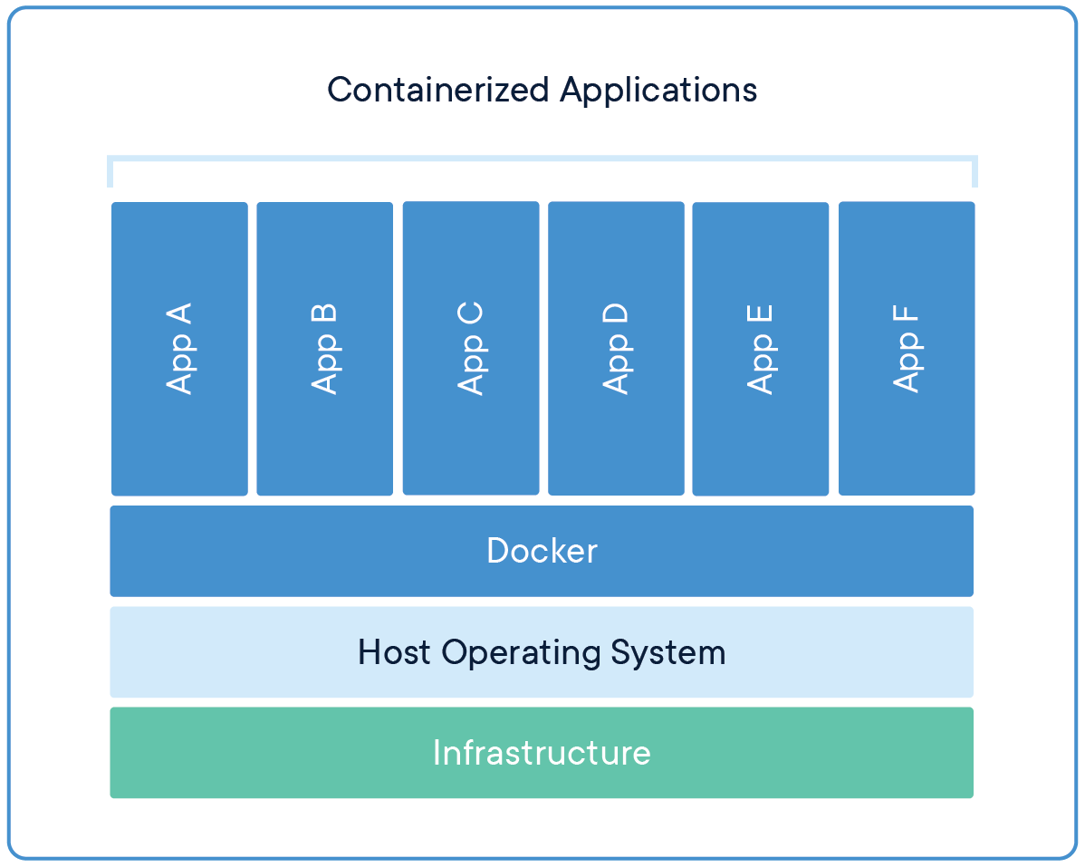
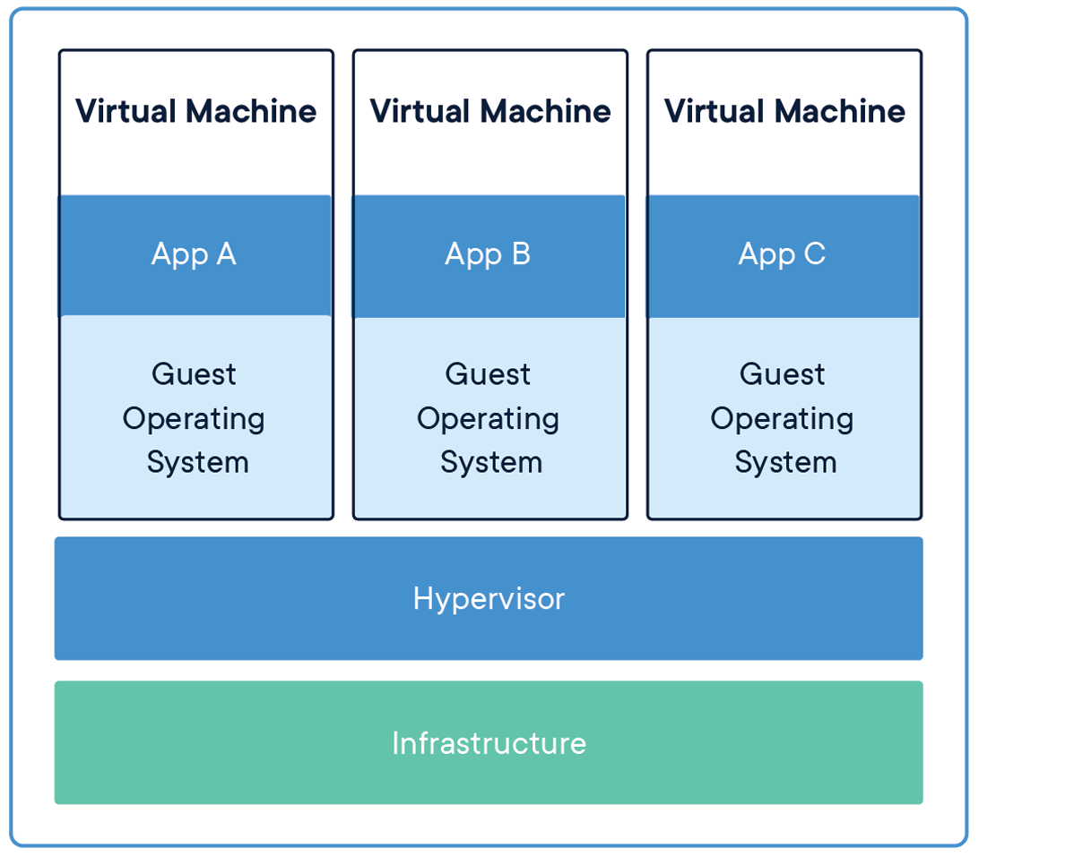
Containers and VM

Slide 13
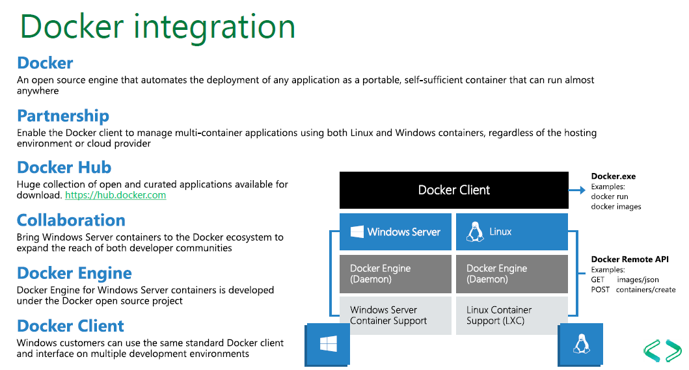


Slide 14
Container Support in Azure Cognitive Services

Slide 15
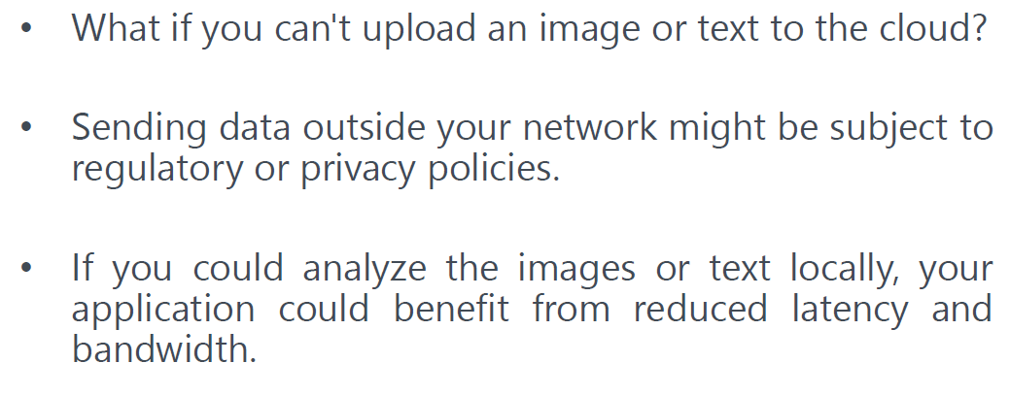
Now, several of the Azure Cognitive Services APIs are available as Docker containers.

Slide 16
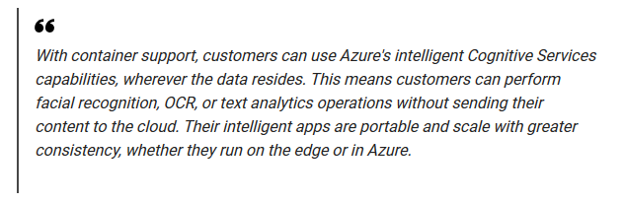

Slide 17
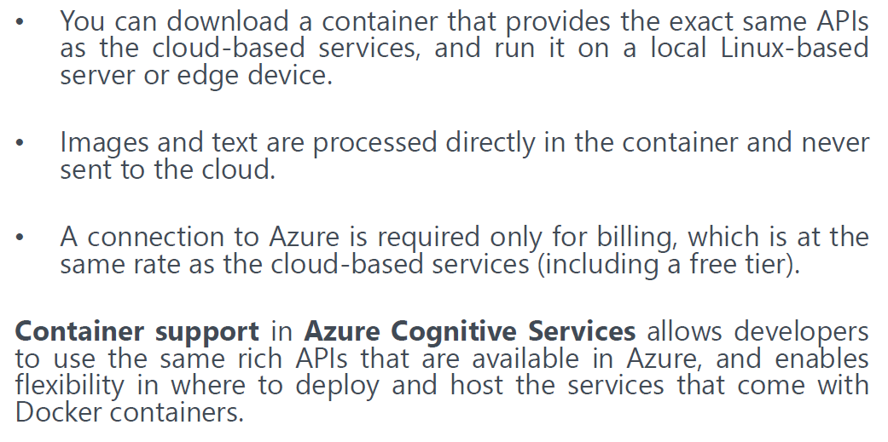

Slide 18
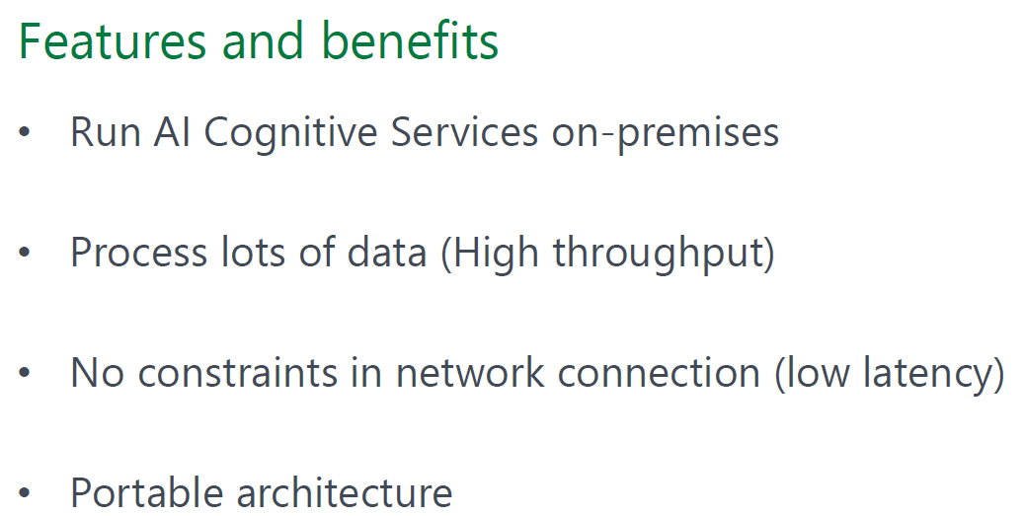

Slide 19
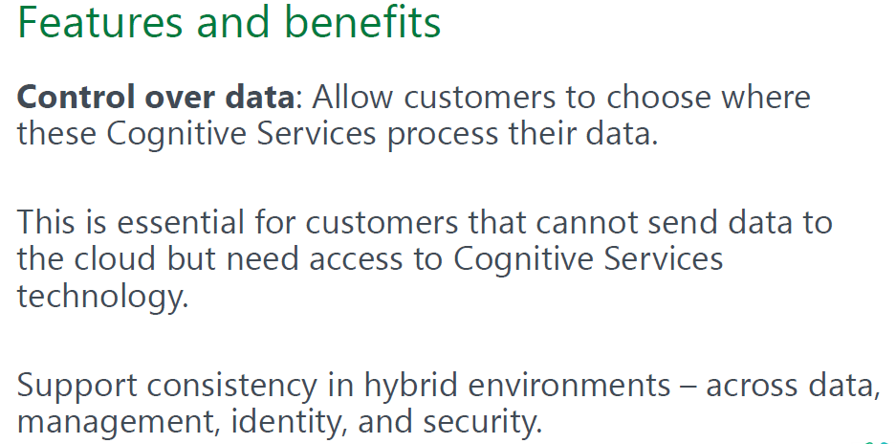

Slide 20
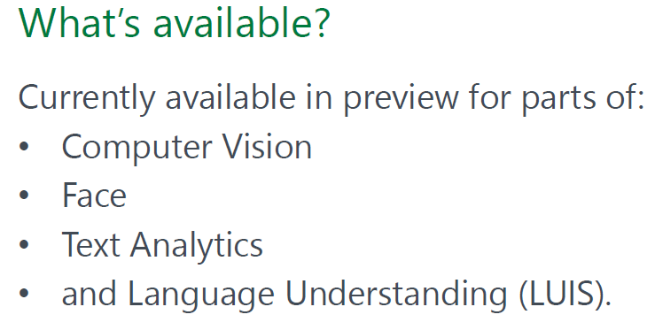

Slide 21
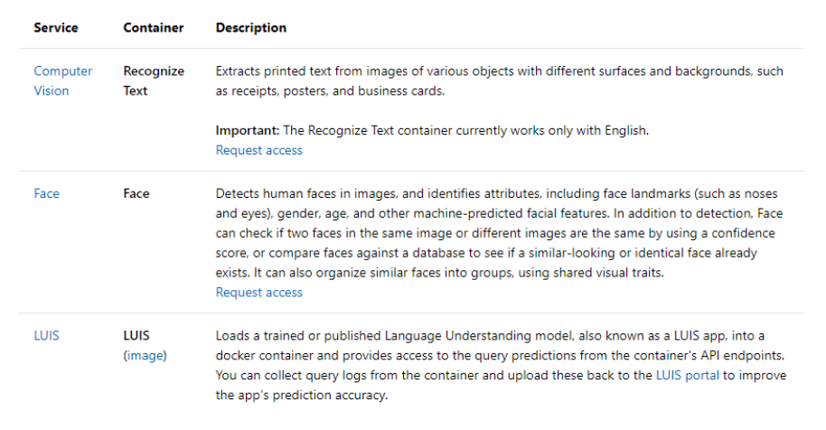

Slide 22
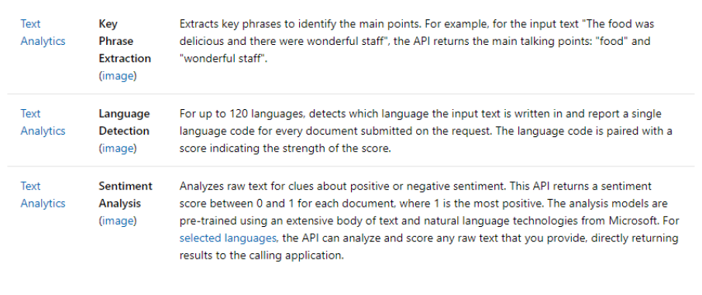

Slide 23
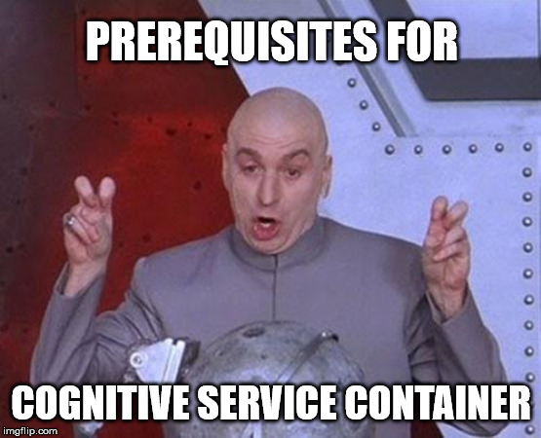

Slide 24
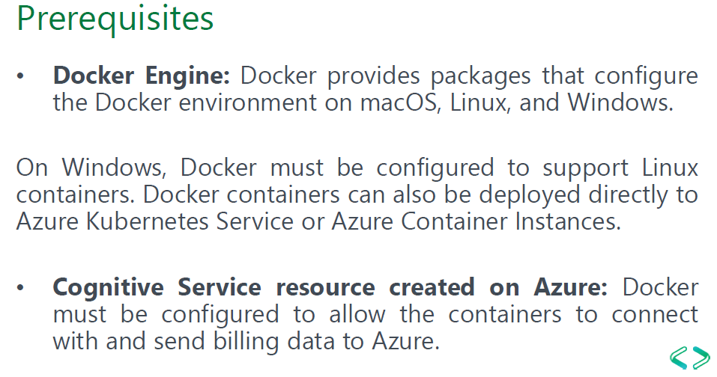


Slide 25
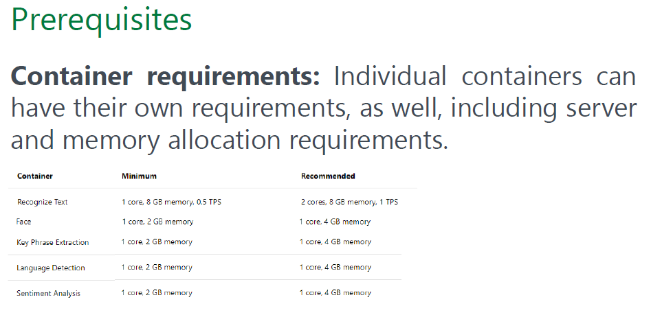

Slide 26
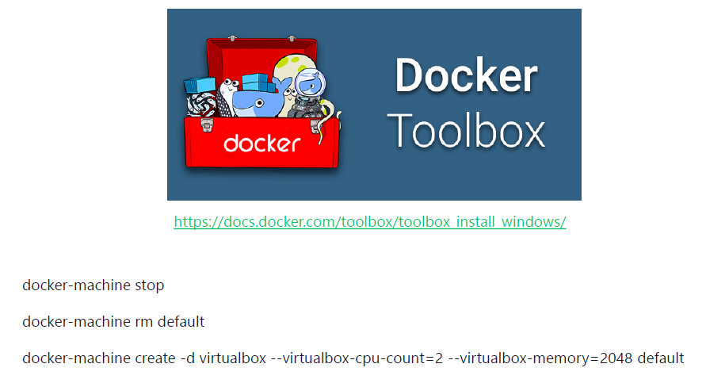

Slide 27


Slide 28
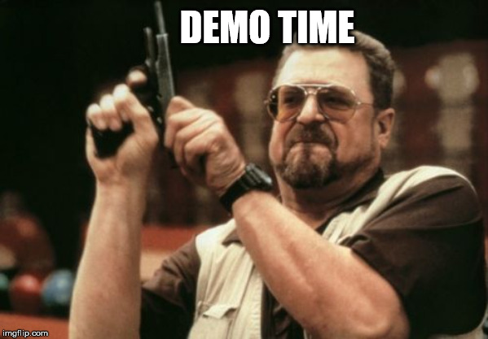
(Text analytics container)

Slide 29
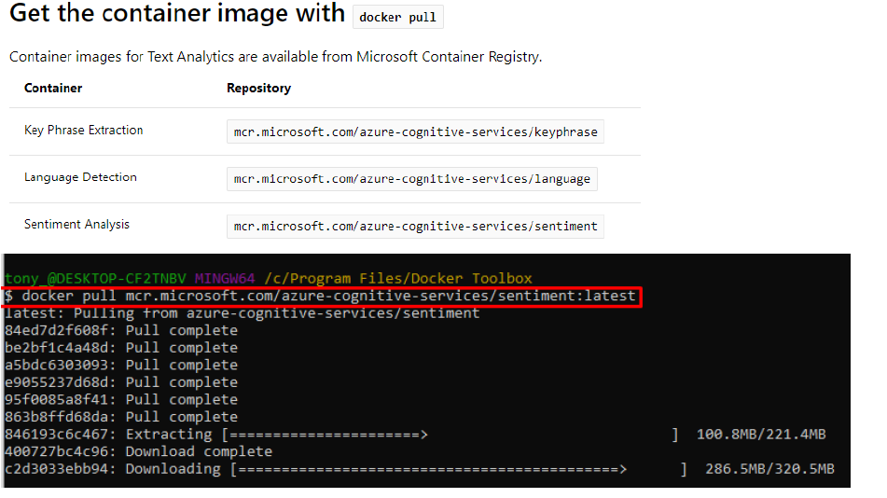

Slide 30
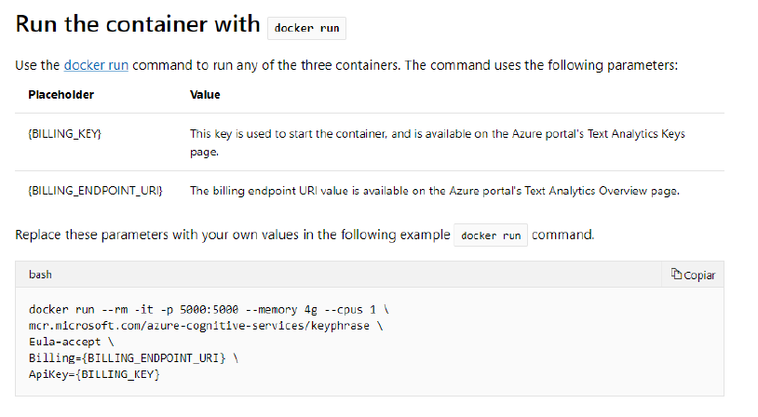

Slide 31
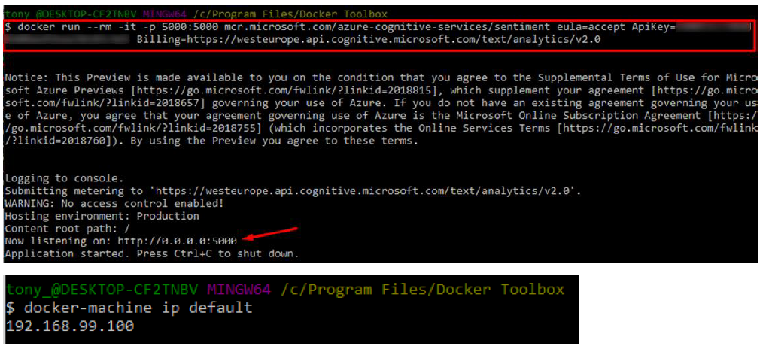

Slide 32
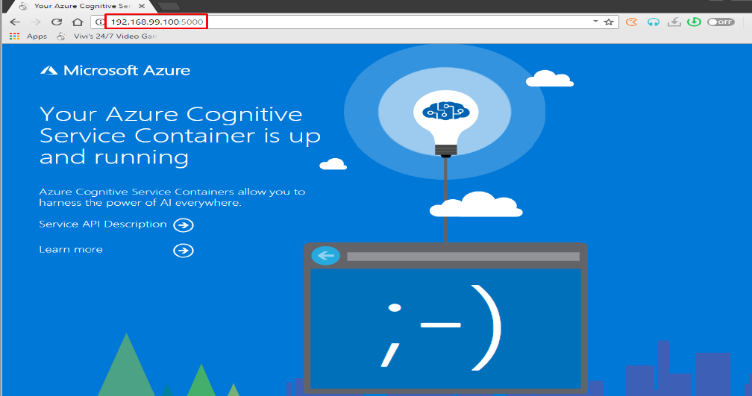

Slide 33
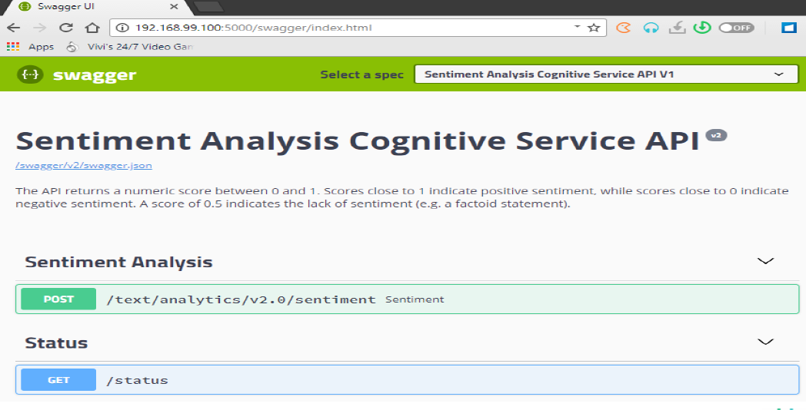

Slide 34
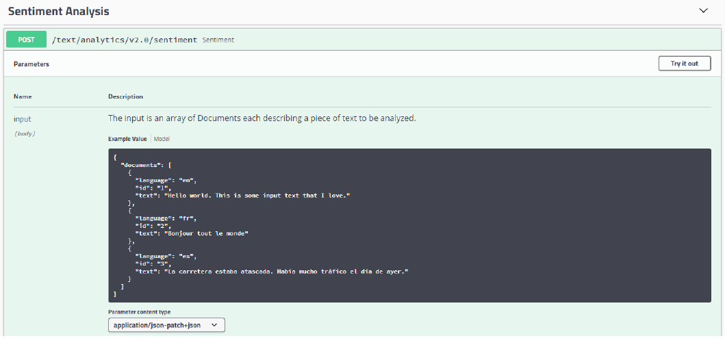

Slide 35
Resources
https://docs.microsoft.com/en-us/azure/cognitive-services/cognitive-services-container-support
https://azure.microsoft.com/en-in/blog/getting-started-with-azure-cognitive-services-in-containers/
https://docs.microsoft.com/en-us/azure/cognitive-services/text-analytics/how-tos/text-analytics-how-to-install-containers

Slide 36


Slide 37
Thank you.
Abhishek Mishra
Software Engineer,
Virtusa
gab@gab.com
gabch.com
@gabchennai

